Slide 1
NLP 220 Data Science and Machine Learning Fundamentals Lecture 13
Jalal Mahmud
jumahmud@ucsc.edu

Slide 2
Data Cleaning:
Another Example

Slide 3
Another Example
I enjoyd the event which took place yesteday &amp; I luvd it ! The link to the show is http://t.co/4ftYom0i It's awsome you'll luv it #HadFun #Enjoyed BFN GN
https://www.geeksforgeeks.org/python-efficient-text-data-cleaning/

Slide 4
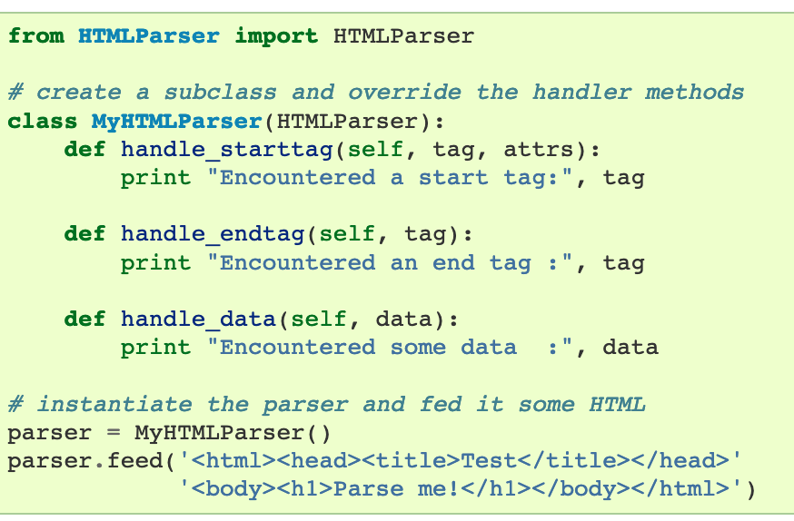
HTML Parser - Background

Slide 5
HTML Parser - Background
# import html
import html
s = '<html><head></head><body><h1>This is python</h1></body></html>'
temp = html.escape(s)
# Using html.unescape() method
gfg = html.unescape(temp)
print(gfg)
https://www.geeksforgeeks.org/html-unescape-in-python/

Slide 6
Another Example
Clear out HTML characters
#Escaping out HTML characters
from html.parser import HTMLParser
tweet="I enjoyd the event which took place yesteday & I lovdddd itttt ! The link to the show is http://t.co/4ftYom0i It's awesome you'll luv it #HadFun #Enjoyed BFN GN"
tweet=HTMLParser().unescape(tweet)
print("After removing HTML characters the tweet is:-\n{}".format(tweet))

Slide 7
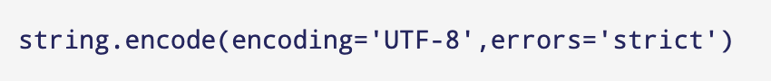
Encoding & Decoding
Using string's encode() method, you can convert unicoded strings into any encodings supported by Python.
By default, Python uses utf-8 encoding.
it takes two parameters:
encoding - the encoding type a string has to be encoded to
errors - response when encoding fails.

Slide 8
Another Example
Encoding & Decoding Data
We should keep our data in a standard encoding format. The most common format is the UTF-8 format.
#Encode from UTF-8 to ascii
encode_tweet =tweet.encode('ascii','ignore')
print("encode_tweet = \n{}".format(encode_tweet))
#decode from ascii to UTF-8
decode_tweet=encode_tweet.decode(encoding='UTF-8')
print("decode_tweet = \n{}".format(decode_tweet))

Slide 9
Removing URLs, Hashtags, Styles
Removing URLs, Hashtags and Styles
#library for regular expressions
import re
# remove hyperlinks
tweet = re.sub(r'https?:\/\/.\S+', "", tweet)
# remove hashtags
# only removing the hash # sign from the word
tweet = re.sub(r'#', '', tweet)
# remove old style retweet text "RT"
tweet = re.sub(r'^RT[\s]+', '', tweet)
print("After removing Hashtags,URLs and Styles the tweet is:-\n{}".format(tweet))

Slide 10
Contraction Replacement
Contraction Replacement
Few of the contractions used are:-
n't --> not 'll --> will 's --> is 'd --> would 'm --> am 've --> have 're --> are
#dictionary consisting of the contraction and the actual value
Apos_dict={"'s":" is","n't":" not","'m":" am","'ll":" will",
"'d":" would","'ve":" have","'re":" are"}
#replace the contractions
for key,value in Apos_dict.items():
if key in tweet:
tweet=tweet.replace(key,value)
print("After Contraction replacement the tweet is:-\n{}".format(tweet))

Slide 11
Slang Lookup
Slang lookup:
There are many slang words which are used nowadays, and they can be found in the text data.
So we need to replace them with their meanings.
asap --> as soon as possible
b4 --> before
lol --> laugh out loud
luv --> love
wtg --> way to go

Slide 12
Standardize and Spell Check
There might be spelling errors in the text or it might not be in the correct format.
For example – “drivng” for “driving” or “I misssss this” for “I miss this”.
#install autocorrect library
pip install autocorrect
from autocorrect import Speller
spell = Speller(lang='en')
#spell check
tweet=spell(tweet)
print("After Spell check the tweet is:-\n{}".format(tweet))

Slide 13
Remove Stopwords
Remove Stopwords:
import nltk
#download the stopwords from nltk using
nltk.download('stopwords')
#import stopwords
from nltk.corpus import stopwords
#import english stopwords list from nltk
stopwords_eng = stopwords.words('english')
tweet_tokens=tweet.split()
tweet_list=[]
#remove stopwords
for word in tweet_tokens:
if word not in stopwords_eng:
tweet_list.append(word)
print("tweet_list = {}".format(tweet_list))

Slide 14
Remove Punctuation
Remove Punctuation
import string
clean_tweet=[]
#remove punctuations
for word in tweet_list:
if word not in string.punctuation:
clean_tweet.append(word)
print("clean_tweet = {}".format(clean_tweet))

Slide 15
Text Vectorization Applied Text Analysis with Python: Enabling Language-Aware Data Products with Machine Learning, Bengfort, Benjamin

Slide 16
Text Vectorization
Machine learning algorithms operate on a numeric feature space, expecting input as a two-dimensional array where rows are instances and columns are features.
In order to perform machine learning on text, we need to transform our documents into vector representations such that we can apply numeric machine learning.
This process is called vectorization

Slide 17
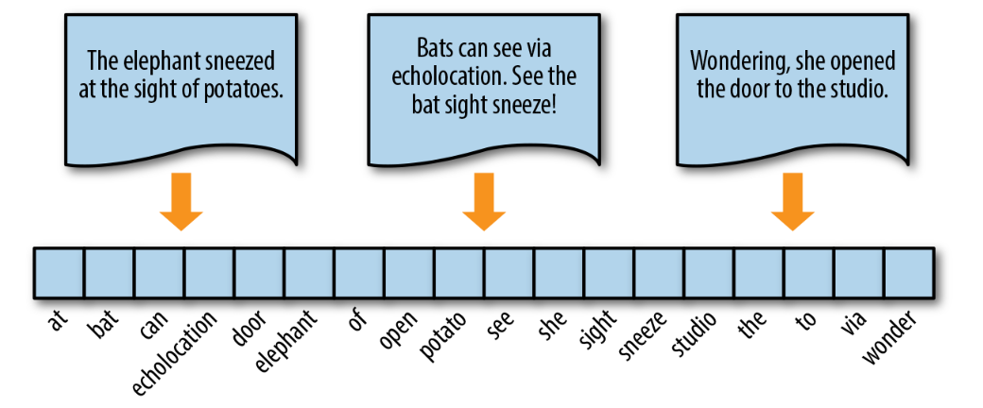
Words in Space

Slide 18
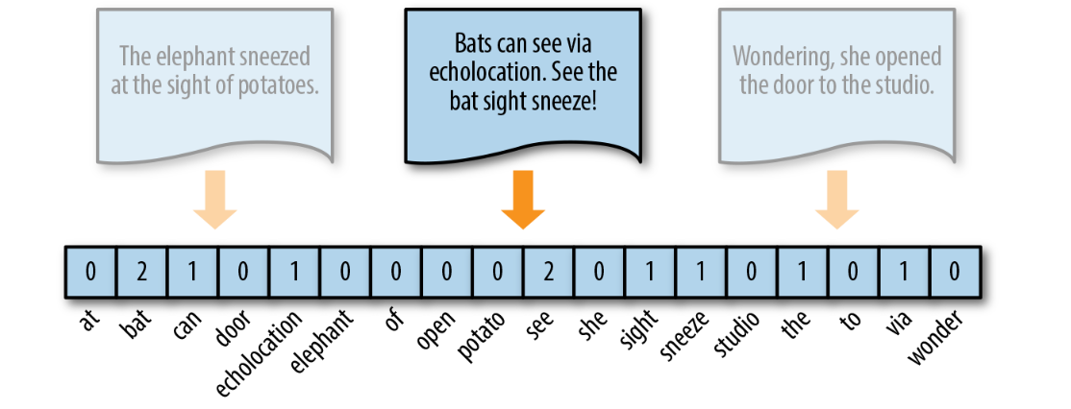
Words in Space - Frequency Vectors
The simplest vector encoding model is to simply fill in the vector with the frequency of each word as it appears in the document.
In this encoding scheme, each document is represented as the multiset of the tokens that compose it and the value for each word position in the vector is its count.

Slide 19
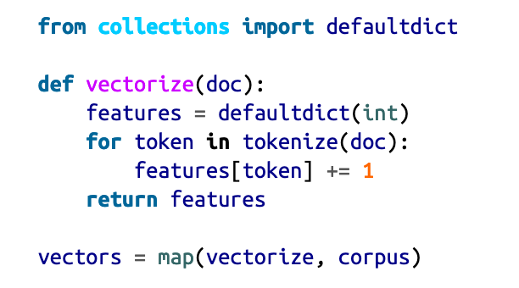
Words in Space - Frequency Vectors

Slide 20
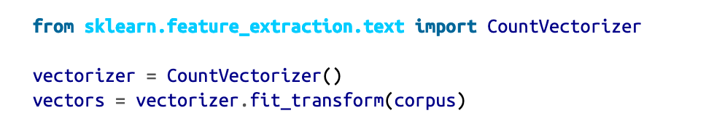
Words in Space - Frequency Vectors
The CountVectorizer transformer from the sklearn.feature_extraction model has its own internal tokenization and normalization methods.
The fit method of the vectorizer expects an iterable or list of strings or file objects, and creates a dictionary of the vocabulary on the corpus.
When transform is called, each individual document is transformed into a sparse array whose index tuple is the row (the documentID) and the token ID from the dictionary, and whose value is the count

Slide 21
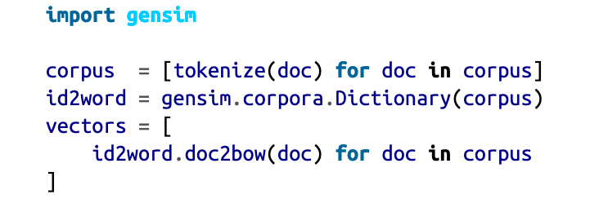
Words in Space - Frequency Vectors
Gensim’s frequency encoder is called doc2bow. To use doc2bow, we first create a Gensim Dictionary that maps tokens to indices based on observed order (eliminating the overhead of lexicographic sorting).
The dictionary object can be loaded or saved to disk, and implements a doc2bow library that accepts a pre-tokenized document and returns a sparse matrix of (id, count) tuples where the id is the token’s id in the dictionary.

Slide 22
Words in Space - Frequency Vectors
Vectors can become extremely sparse, particularly as vocabularies get larger, which can have a significant impact on the speed and performance of machine learning models.
For very large corpora, it is recommended to use the Scikit-Learn HashingVectorizer, which uses a hashing trick to find the token string name to feature index mapping.

Slide 23
Words in Space - One-Hot Encoding
Because they disregard grammar and the relative position of words in documents, frequency-based encoding methods suffer from the long tail, or Zipfian distribution, that characterizes natural language.
As a result, tokens that occur very frequently are orders of magnitude more “significant” than other, less frequent ones.
This can have a significant impact on some models (e.g., generalized linear models) that expect normally distributed features.

Slide 24
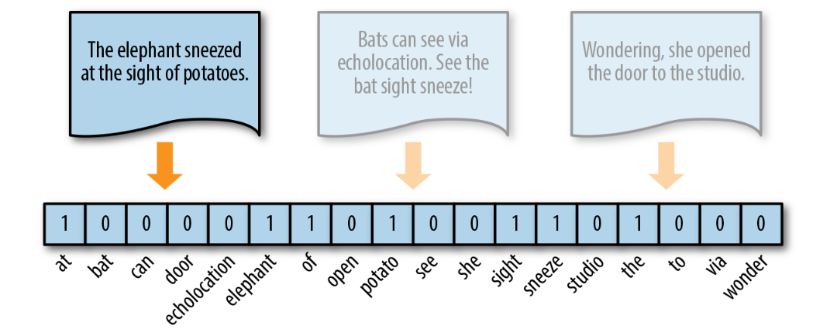
Words in Space - One-Hot Encoding
A solution to this problem is one-hot encoding, a boolean vector encoding method that marks a particular vector index with a value of true (1) if the token exists in the document and false (0) if it does not.

Slide 25
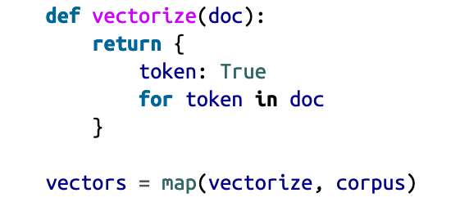
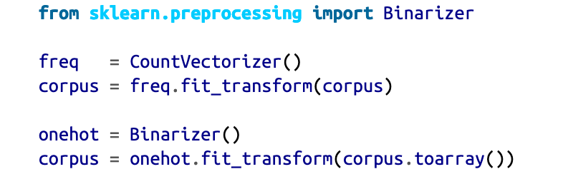
Words in Space - One-Hot Encoding
One-hot encoding reduces the imbalance issue of the distribution of tokens, simplifying a document to its constituent components.
This reduction is most effective for very small documents (sentences, tweets) that don’t contain very many repeated elements, and is usually applied to models that have very good smoothing properties

Slide 26
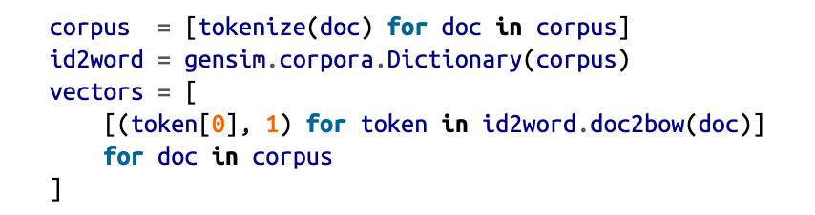
Words in Space - One-Hot Encoding
While Gensim does not have a specific one-hot encoder, its doc2bow method returns a list of tuples that we can manage on the fly.

Slide 27
Words in Space - One-Hot Encoding
One-hot encoding represents similarity and difference at the document level, but because all words are rendered equidistant, it is not able to encode per-word similarity.
Moreover, because all words are equally distant, word form becomes incredibly important; the tokens “trying” and “try” will be equally distant from unrelated tokens like “red” or “bicycle”!

Slide 28
Words in Space - One-Hot Encoding
Normalizing tokens to a single word class, either through stemming or lemmatization, ensures that different forms of tokens that embed plurality, case, gender, cardinality, tense, etc., are treated as single vector components.
This reduces the feature space and makes models more performant.

Slide 29
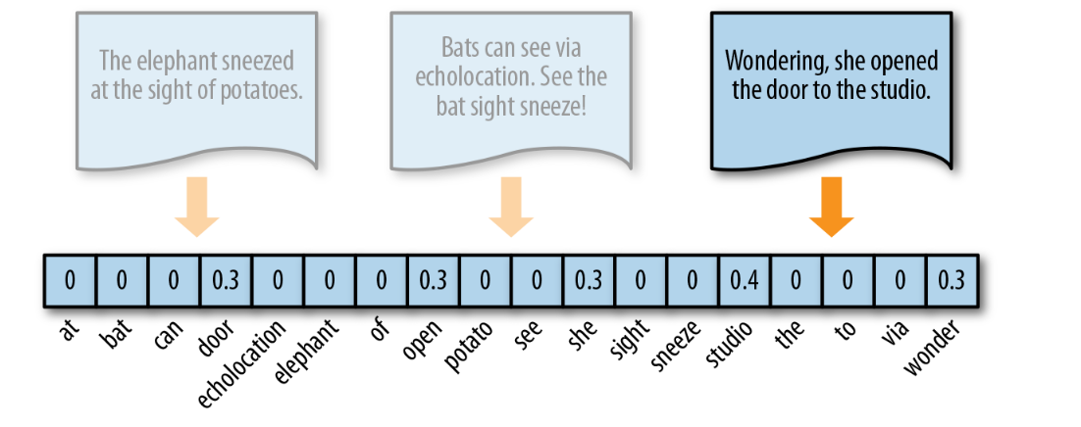
Words in Space - Term Frequency–Inverse Document Frequency
TF–IDF, term frequency–inverse document frequency, encoding normalizes the frequency of tokens in a document with respect to the rest of the corpus. This encoding approach accentuates terms that are very relevant to a specific instance

Slide 30
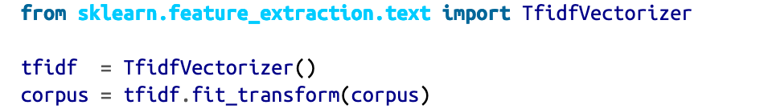
Words in Space - Term Frequency–Inverse Document Frequency
TF–IDF is computed on a per-term basis, such that the relevance of a token to a document is measured by the scaled frequency of the appearance of the term in the document, normalized by the inverse of the scaled frequency of the term in the entire corpus.

Slide 31
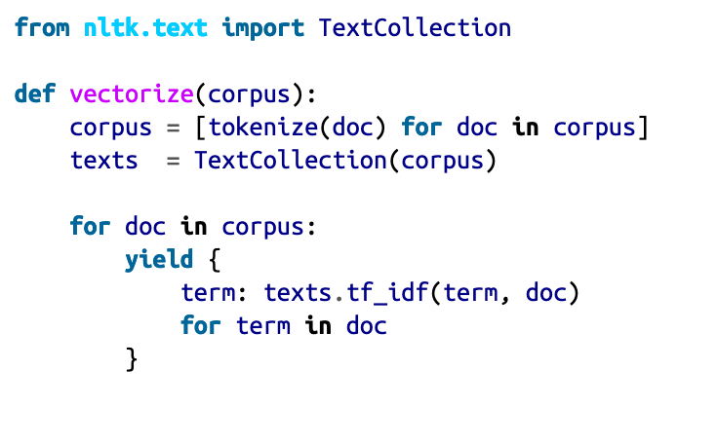
Term Frequency–Inverse Document Frequency
To vectorize text in this way with NLTK, we use the TextCollection class, a wrapper for a list of texts or a corpus consisting of one or more texts.
This class provides sup‐port for counting, concordancing, collocation discovery, and more importantly, computing tf_idf.

Slide 32
Term Frequency–Inverse Document Frequency
The Gensim way
In Gensim, the TfidfModel data structure is similar to the Dictionary object in that it stores a mapping of terms and their vector positions in the order they are observed, but additionally stores the corpus frequency of those terms so it can vectorize documents on demand.
Gensim allows us to apply our own tokenization method, expecting a corpus that is a list of lists of tokens.
We first construct the lexicon and use it to instantiate the TfidfModel, which computes the normalized inverse document frequency.

Slide 33
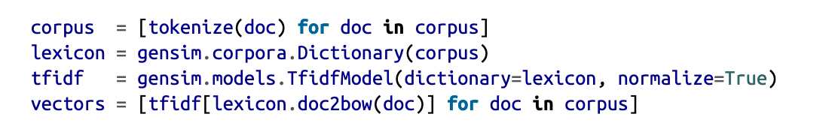
Term Frequency–Inverse Document Frequency
The Gensim way

Slide 34
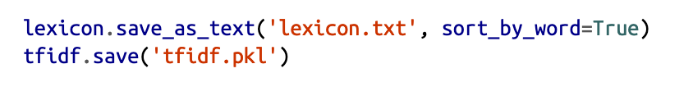
Term Frequency–Inverse Document Frequency
The Gensim way
Gensim provides helper functionality to write dictionaries and models to disk in a compact format, meaning you can conveniently save both the TF–IDF model and the lexicon to disk in order to load them later to vectorize new documents.
It is possible (though slightly more work) to achieve the same result by using the pickle module in combination with Scikit-Learn. To save a Gensim model to disk:
This will save the lexicon as a text-delimited text file, sorted lexicographically, and the TF–IDF model as a pickled sparse matrix.

Slide 35
Term Frequency–Inverse Document Frequency
One benefit of TF–IDF is that it naturally addresses the problem of stop words, those words most likely to appear in all documents in the corpus (e.g., “a,” “the,” “of ”, etc.), and thus will accrue very small weights under this encoding scheme.
This biases the TF–IDF model toward moderately rare words. As a result TF–IDF is widely used for bag-of-words models, and is an excellent starting point for most text analytics

Slide 36
Distributed Representation
Frequency, one-hot, and TF–IDF encoding enable us to put documents into vector space.
However, it is often useful to also encode the similarities between documents in the context of that same vector space.

Slide 37
Distributed Representation
When document similarity is important in the context of an application, we instead encode text along a continuous scale with a distributed representation.
This means that the resulting document vector is not a simple mapping from token position to token score.
Instead, the document is represented in a feature space that has been embedded to represent word similarity.

Slide 38
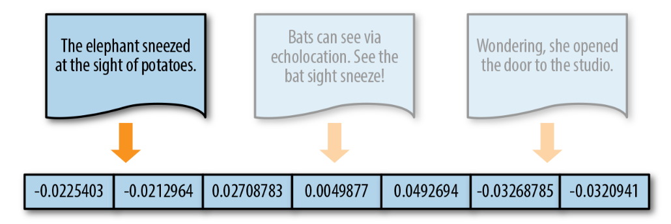
Distributed Representation

Slide 39
Distributed Representation
Word2vec, created by a team of researchers at Google.
This implements a word embedding model that enables us to create these kinds of distributed representations.
The word2vec algorithm trains word representations based on either a continuous bag-of-words (CBOW) or skip-gram model.
words are embedded in space along with similar words
based on their context.
Gensim’s implementation uses a feedforward network.

Slide 40
Distributed Representation
Word embedding is one of the most popular representation of document vocabulary.
It is capable of capturing context of a word in a document, semantic and syntactic similarity, relation with other words, etc.
Word2Vec is one of the most popular technique to learn word embeddings using shallow neural network

Slide 41
Distributed Representation
Word2Vec original paper:
Distributed Representations of Words and Phrases and their Compositionality
https://arxiv.org/pdf/1310.4546.pdf

Slide 42
Distributed Representation
Why do we need them?
Intuitively, we introduce some dependence of one word on the other words.
The words in context of this word would get a greater share of this dependence.
In one hot encoding representations, all the words are independent of each other, as mentioned earlier.
https://towardsdatascience.com/introduction-to-word-embedding-and-word2vec-652d0c2060fa

Slide 43
Distributed Representation
Why do we need them?
Consider the following similar sentences:
Have a good day and Have a great day.
They hardly have different meaning.
If we construct an exhaustive vocabulary (let’s call it V),
it would have V = {Have, a, good, great, day}.
https://towardsdatascience.com/introduction-to-word-embedding-and-word2vec-652d0c2060fa

Slide 44
Distributed Representation
Why do we need them?
Now, let us create a one-hot encoded vector for each of these words in V.
Length of our one-hot encoded vector would be equal to the size of V (=5).
We would have a vector of zeros except for the element at the index representing the corresponding word in the vocabulary.
That particular element would be one. The encodings below would explain this better.
Have = [1,0,0,0,0]`; a=[0,1,0,0,0]` ; good=[0,0,1,0,0]` ; great=[0,0,0,1,0]` ; day=[0,0,0,0,1]`
https://towardsdatascience.com/introduction-to-word-embedding-and-word2vec-652d0c2060fa

Slide 45
Distributed Representation
Why do we need them?
If we try to visualize these encodings, we can think of a 5 dimensional space, where each word occupies one of the dimensions and has nothing to do with the rest (no projection along the other dimensions).
This means ‘good’ and ‘great’ are as different as ‘day’ and ‘have’, which is not true.
Our objective is to have words with similar context occupy close spatial positions.
Mathematically, the cosine of the angle between such vectors should be close to 1, i.e. angle close to 0.
https://towardsdatascience.com/introduction-to-word-embedding-and-word2vec-652d0c2060fa

Slide 46
Distributed Representation
Why do we need them?
Here comes the idea of generating distributed representations.
Intuitively, we introduce some dependence of one word on the other words.
The words in context of this word would get a greater share of this dependence.
In one hot encoding representations, all the words are independent of each other, as mentioned earlier.
https://towardsdatascience.com/introduction-to-word-embedding-and-word2vec-652d0c2060fa

Slide 47
Distributed Representation
How Does Word2Vec work?
Word2Vec is a method to construct such an embedding. It can be obtained using two methods (both involving Neural Networks): Skip Gram and Common Bag Of Words (CBOW).
CBOW Model: This method takes the context of each word as the input and tries to predict the word corresponding to the context.
Skip-Gram model: This looks like multiple-context CBOW model.
Skip Gram works well with small amount of data and is found to represent rare words well.
On the other hand, CBOW is faster and has better representations for more frequent words.
https://towardsdatascience.com/introduction-to-word-embedding-and-word2vec-652d0c2060fa

Slide 48
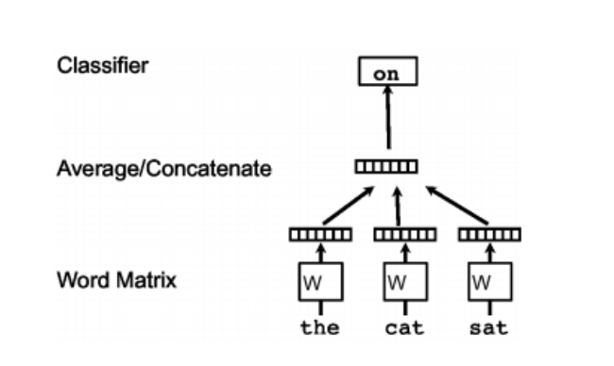
Distributed Representation
How Does Word2Vec work?
Continuous bag of words
Continuous bag of words creates a sliding window around current word, to predict it from “context” — the surrounding words. Each word is represented as a feature vector. After training, these vectors become the word vectors.
https://towardsdatascience.com/introduction-to-word-embedding-and-word2vec-652d0c2060fa

Slide 49
Distributed Representation
How Does Word2Vec work?
Skip gram
The second algorithm is actually the opposite of CBOW: instead of prediciting one word each time, we use 1 word to predict all surrounding words (“context”).
Skip gram is much slower than CBOW, but considered more accurate with infrequent words.
https://medium.com/wisio/a-gentle-introduction-to-doc2vec-db3e8c0cce5e

Slide 50
Distributed Representation
The doc2vec algorithm is an extension of word2vec.
The goal of doc2vec is to create a numeric representation of a document, regardless of its length.
But unlike words, documents do not come in logical structures such as words, so the another method has to be found.
It proposes a paragraph vector—an unsupervised algorithm that learns fixed-length feature representations from variable length documents.
This representation attempts to inherit the semantic properties of words such that “red” and “colorful” are more similar to each other than they are to “river” or “governance”.

Slide 51
Distributed Representation
The paragraph vector takes into consideration the ordering of words within a narrow context, similar to an n-gram model.
The combined result is much more effective than a bag-of-words or bag-of-n-grams model because it generalizes better.

Slide 52
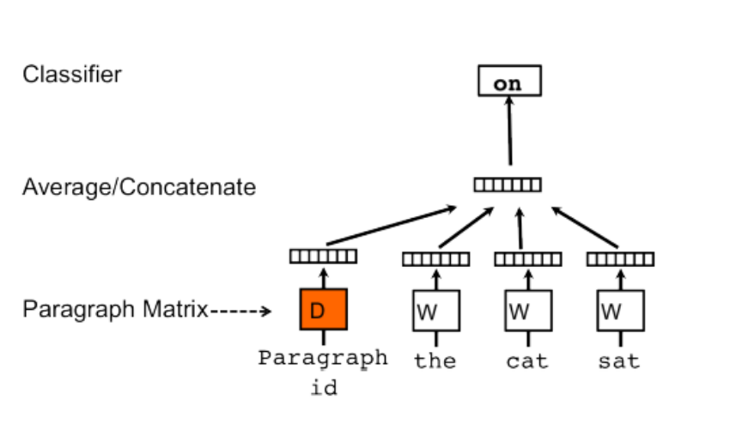
Distributed Representation
The concept that Mikilov and Le have used was simple, yet clever: they have used the word2vec model, and added another vector (Paragraph ID below), like so:
https://medium.com/wisio/a-gentle-introduction-to-doc2vec-db3e8c0cce5e

Slide 53
Distributed Representation
It is a small extension to the CBOW model.
But instead of using just words to predict the next word, we also added another feature vector, which is document-unique.
So, when training the word vectors W, the document vector D is trained as well, and in the end of training, it holds a numeric representation of the document.
https://medium.com/wisio/a-gentle-introduction-to-doc2vec-db3e8c0cce5e

Slide 54
Distributed Representation – Gensim’s Implementation

Slide 55
Distributed Representation – Gensim’s Implementation
Neither NLTK nor Scikit-Learn provide implementations of these kinds of word embeddings.
Gensim’s implementation allows users to train both word2vec and doc2vec models on custom corpora and also conveniently comes with a model that is pretrained on the Google news corpus.
To use Gensim’s pretrained models, you’ll need to download the model bin file, which is about 1.5 GB.

Slide 56
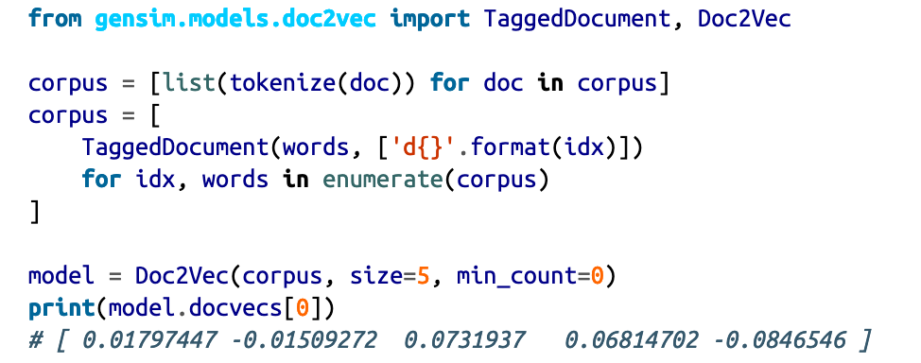
Distributed Representation – Gensim’s Implementation

Slide 57
Distributed Representation – Summary
Distributed representations will dramatically improve results over TF–IDF models when used correctly.
The model itself can be saved to disk and retrained in an active fashion, making it extremely flexible for a variety of use cases.

Slide 58
Distributed Representation – Summary
However, on larger corpora, training can be slow and memory intensive, and it might not be as good as a TF–IDF model with Principal Component Analysis (PCA) or Singular Value Decomposition (SVD) applied to reduce the feature space.
In the end, however, this representation is breakthrough work that has led to a dramatic improvement in text processing capabilities of data products in recent years.

Slide 59
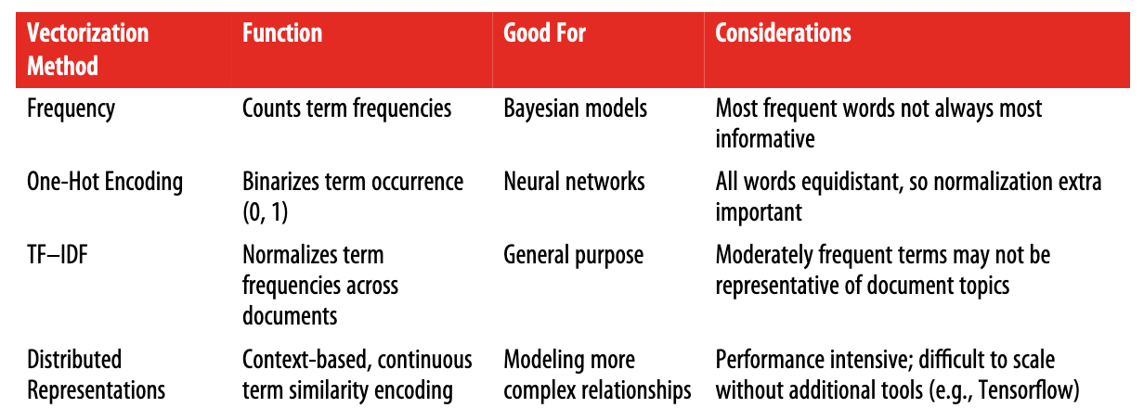
Overview of Text Vectorization Methods

Slide 60
Data Wrangling with Pandas
https://towardsdatascience.com/data-wrangling-with-pandas-5b0be151df4e

Slide 61
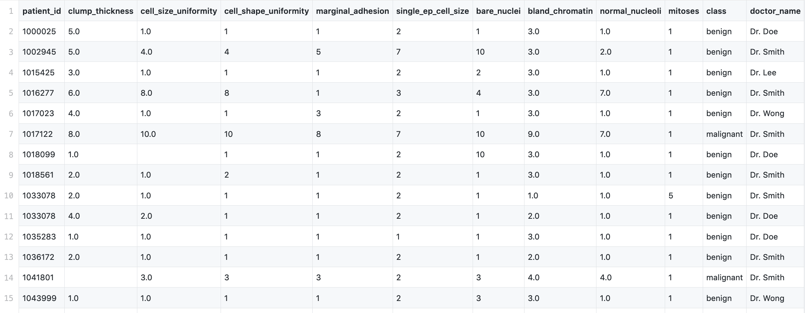
Data Wrangling with Pandas
Data exploration
https://github.com/moeraza/pandas_data_wrangling/blob/master/data/breast_cancer_data.csv
https://towardsdatascience.com/data-wrangling-with-pandas-5b0be151df4e

Slide 62
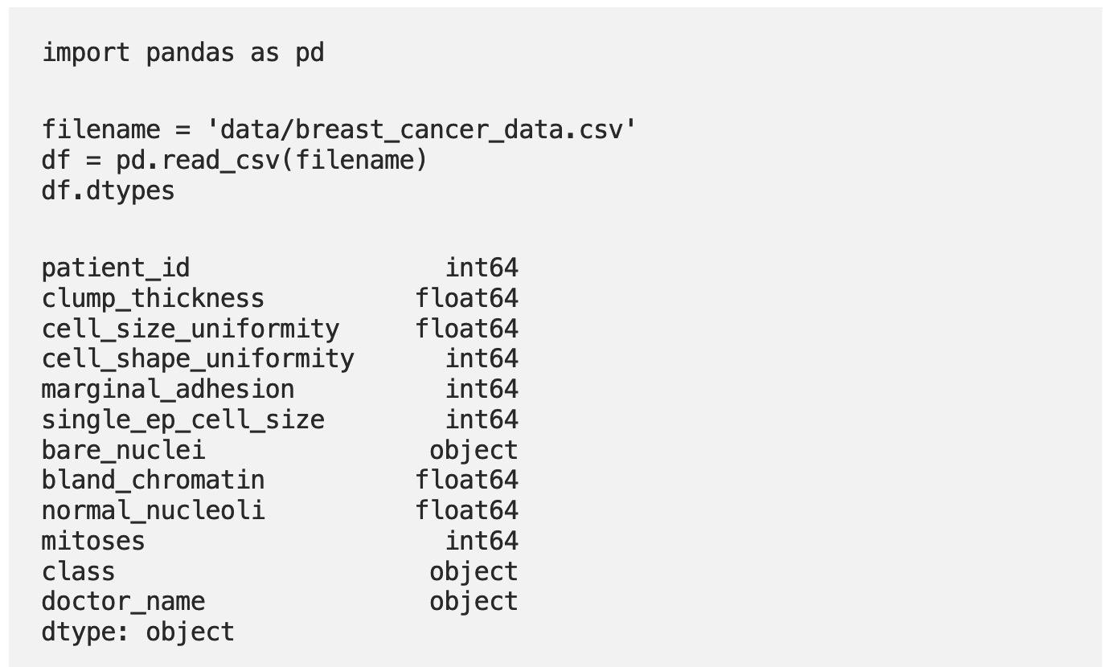
Data Wrangling with Pandas
Data exploration
https://towardsdatascience.com/data-wrangling-with-pandas-5b0be151df4e

Slide 63
Data Wrangling with Pandas
Data exploration
We can assume that patient_id is a unique identifier,
Class is going to tell us whether the tumor is malignant (cancerous) or benign (not cancerous).
The remaining columns are numeric medical descriptions of the tumor, except for the doctor_name which is a categorical feature.
https://towardsdatascience.com/data-wrangling-with-pandas-5b0be151df4e

Slide 64
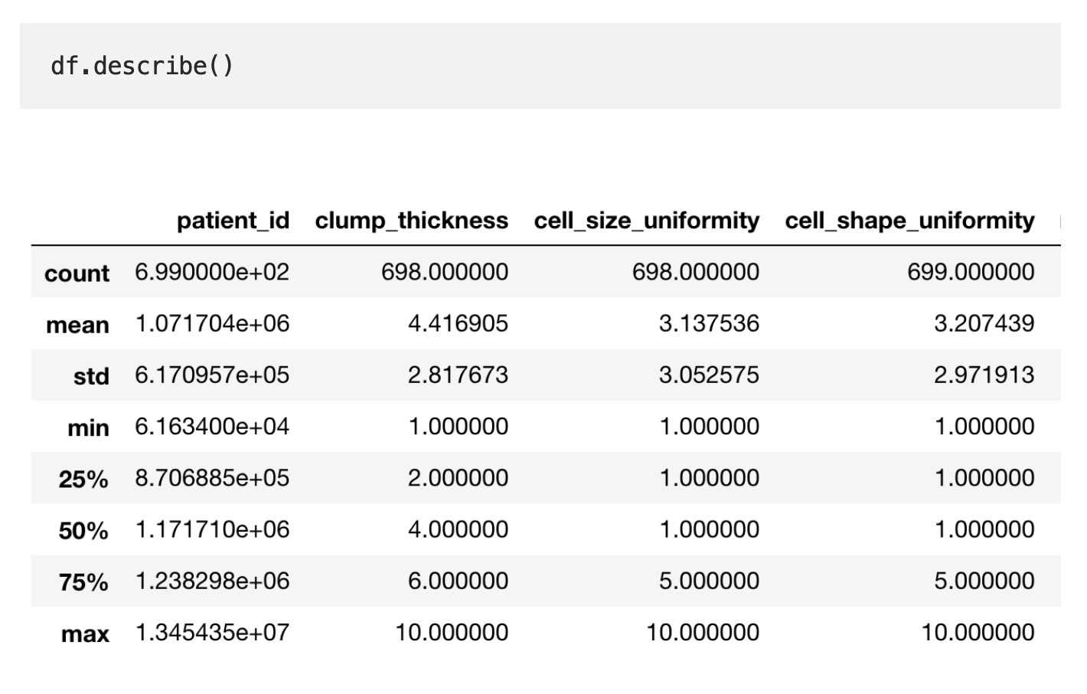
Data Wrangling with Pandas

Slide 65
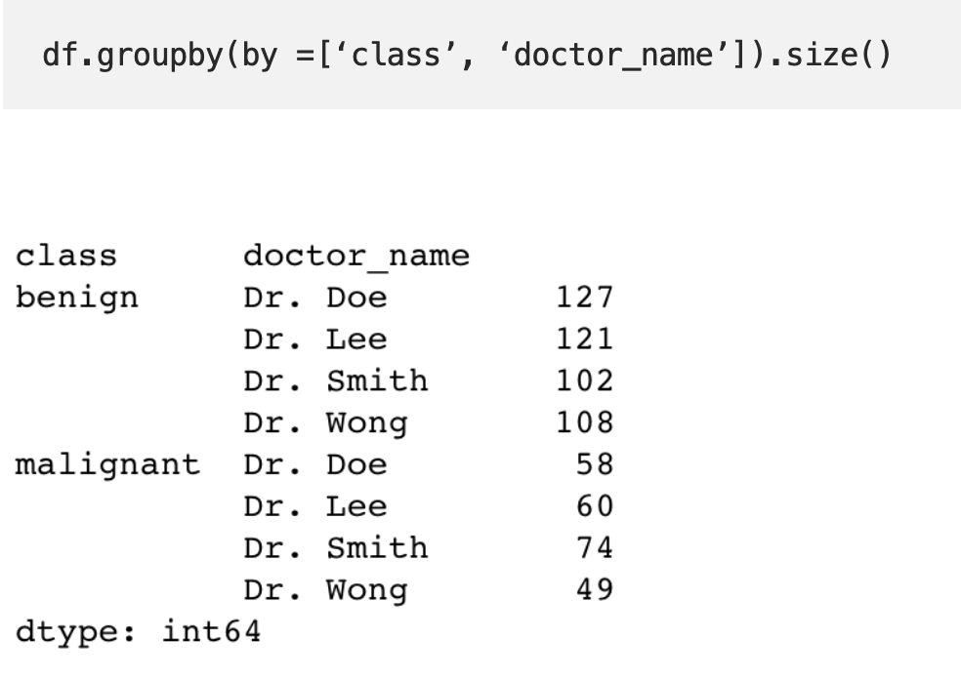
Data Wrangling with Pandas
For categorical data we can hand this by grouping together values:

Slide 66
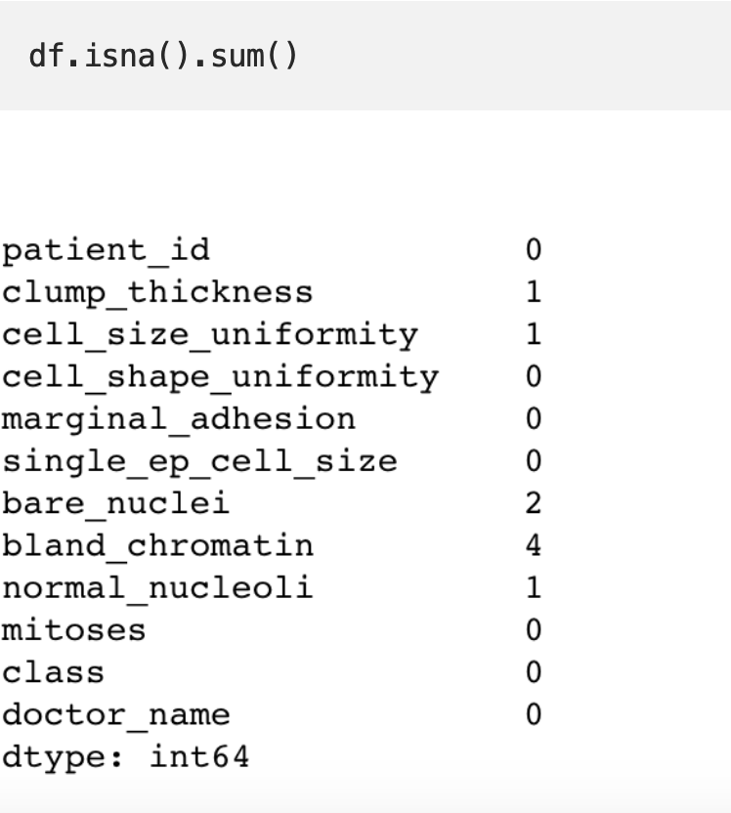
Dealing with Missing Values
With every dataset it is vital to evaluate the missing values. How many are there? Is it an error? Are there too many missing values?

Slide 67
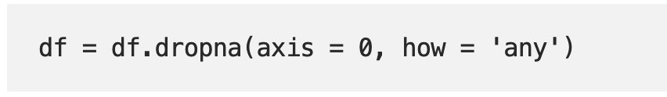
Dealing with Missing Values
Now that we have identified our missing values, we have a few options.
We can fill them in with a certain value (zero, mean/max/median by column, string) or drop them by row.
Since there are few missing values, we can drop the rows to avoid skewing the data

Slide 68
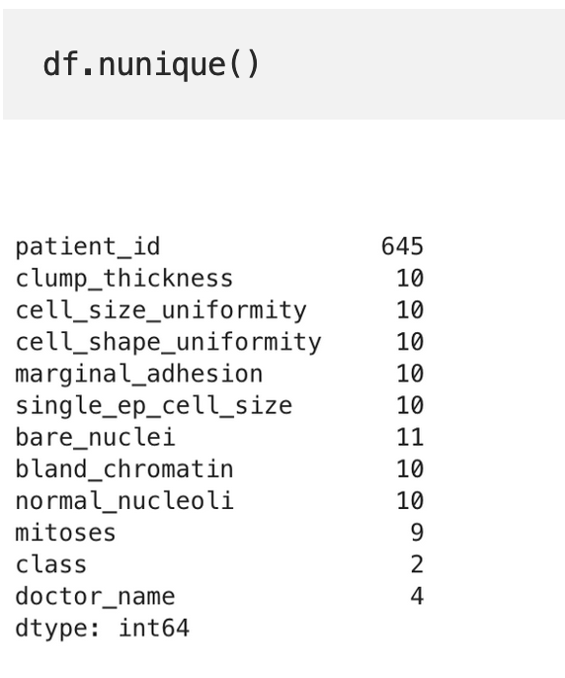
Inspecting Duplicates
We see here that although there are 699 rows, there are only 645 unique patient_id’s. This could mean that some patient appear more than once in the dataset.

Slide 69
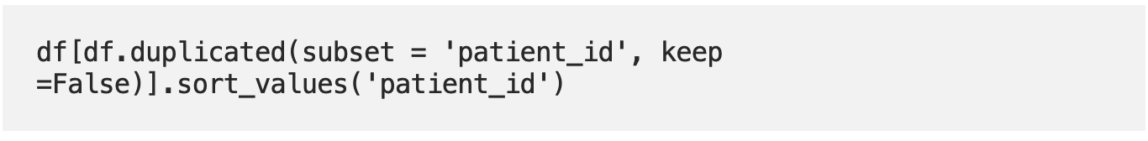
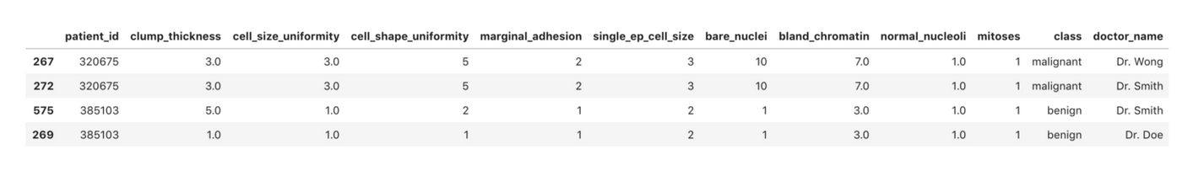
Inspecting Duplicates

Slide 70
Filtering Data

Slide 71
Row-wise Operations

Slide 72
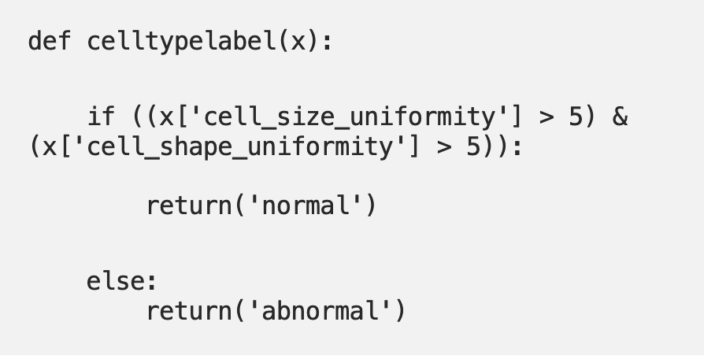
Row-wise Operations
Another key component in data wrangling is having the ability to conduct row-wise or column wise operations.
Examples of this are; rename elements within a column based on its value and create a new column that yields a specific value based on multiple attributes within the row.

Slide 73
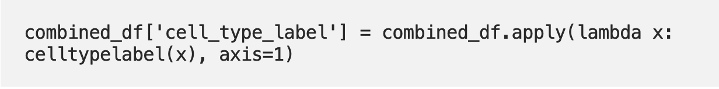
Row-wise Operations
Then we use the pandas apply function to run the celltypelabel(x) function on the data-frame.

Slide 74
Let’s Look at Few More Datasets

Slide 75
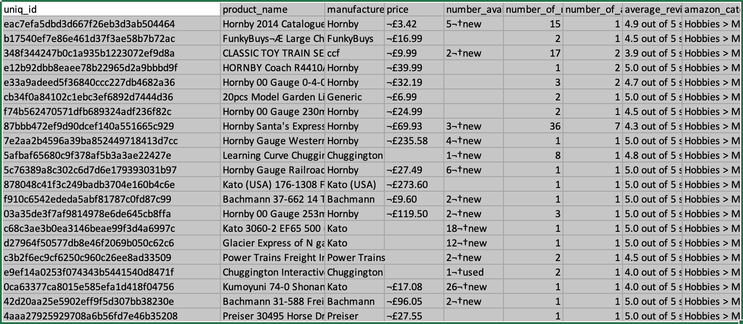
Amazon E-Commerce Dataset

Slide 76
What are the problems with this dataset?

Slide 77
More Twitter Datasets

Slide 78
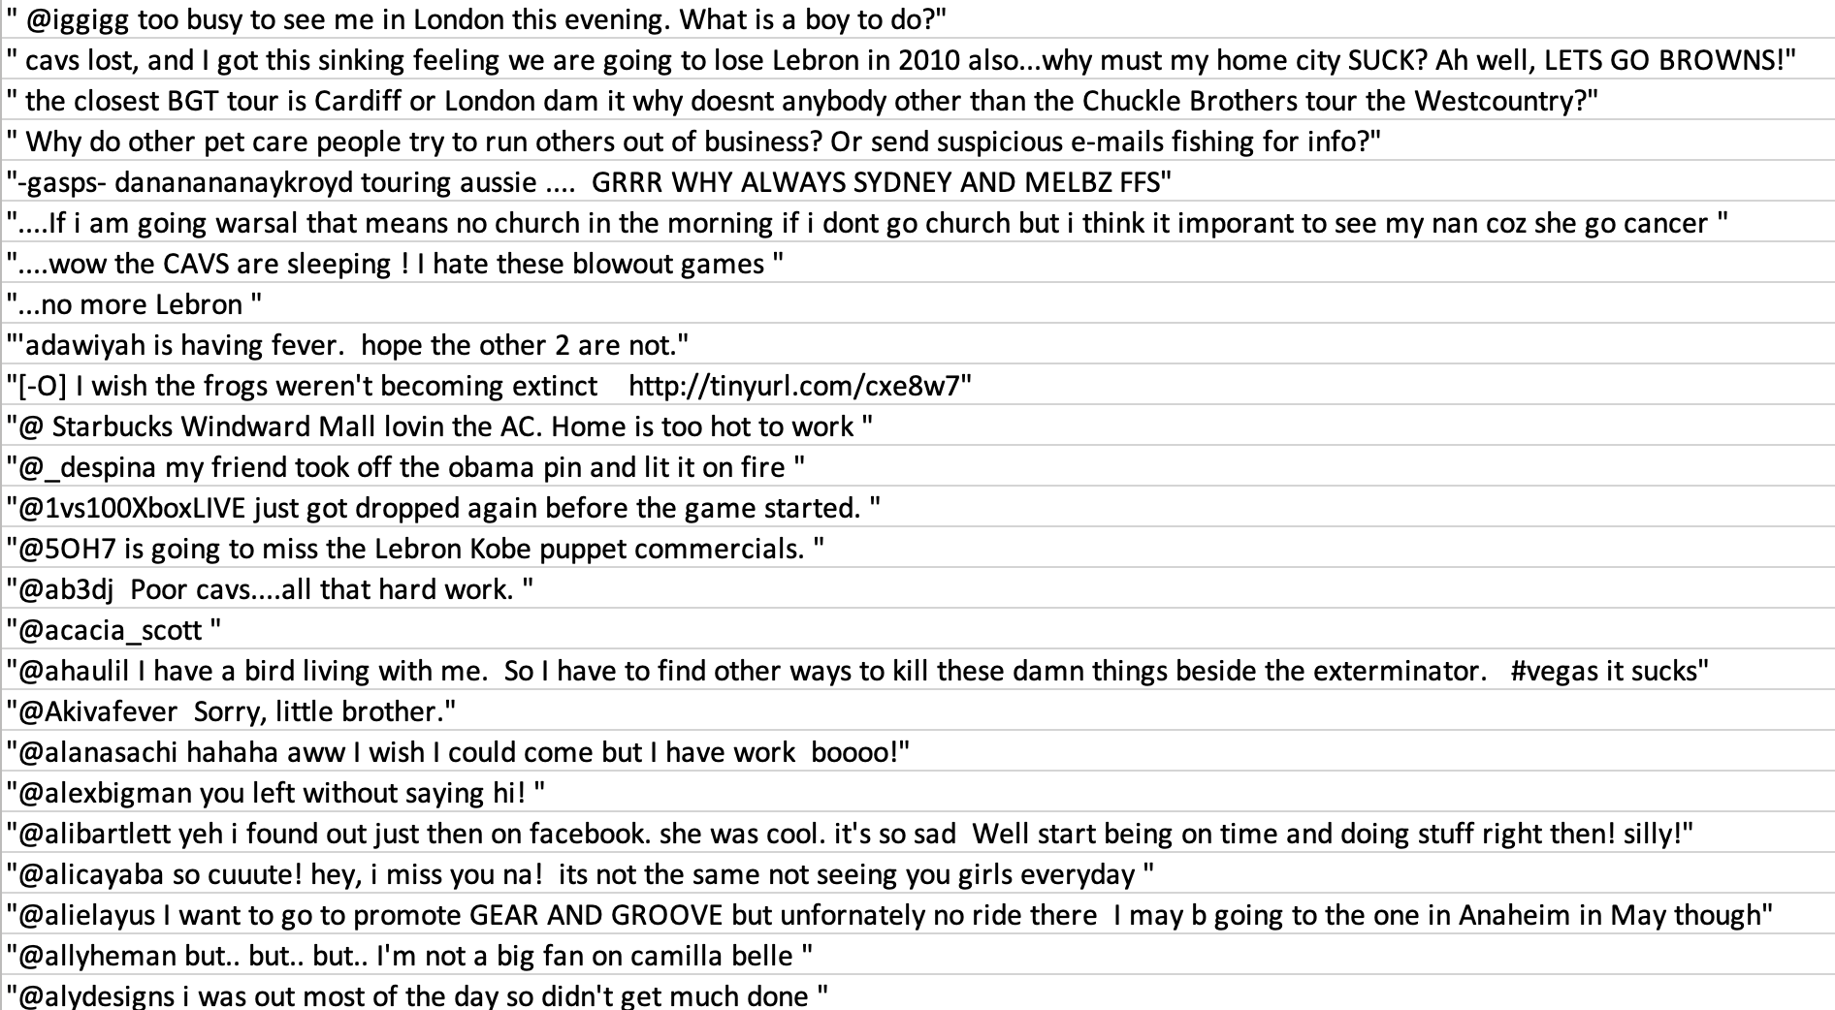

Slide 79
What are the problems with this dataset?

Slide 80
Noise In Industry Datasets http://noisy-text.github.io/2018/pdf/W-NUT201814.pdf

Slide 81
Common types of industry noise
Occasionally, documents are replicated and some document could be assigned conflicting labels.
For example, a single document could describe several entities, such as multiple participants in a car accident with document labels derived from their associated medical billing codes.
The difference between a subset of the document labels could vary. Some labels could be close to interchangeable because of various business reasons, while others are clearly separated.

Slide 82
Common types of industry noise
For some labels, label assignment can be clear-cut and objective, while for others, human labelers are left to make a subjective choice.
Some documents were truncated as an artifact of the export process.
The information needed to assign correctly a label is missing from the text document, and instead the human labeler consulted a different source.
There is a large amount of document text irrelevant to the labeling task at hand, an artifact of the business workflow and/or export process.

Slide 83
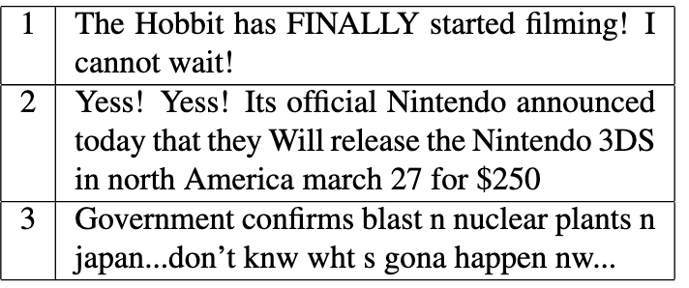
Data Preprocessing/Cleaning: When to do what?
Should you always transform to lower case?
Not necessarily. For entity recognition, capitalization is important!
Named Entity Recognition in Tweets:An Experimental Study
https://homes.cs.washington.edu/~mausam/papers/emnlp11.pdf

Slide 84
Data Preprocessing/Cleaning: When to do what?
Emoticons, which are made up of non-alphabets also play a role in sentiment analysis. “:), :(, -_-, :D, xD”, all these, when processed correctly, can help with a better sentiment analysis.
Even if you want to develop a system that may classify whether some phrase is sarcasm, or not sarcasm, such little details can be helpful.
In applications like document search engines and document classification, where keywords are more important than general terms, removing stopwords can be a good idea.
If there’s some application about, for instance, songs lyrics search, or search specific quotes, stopwords can be important. Consider some examples like “To be, or not not be”, “Look what you made me do” etc.

Slide 85
Data Preprocessing/Cleaning: When to do what?
The process of stemming and lemmatization should be performed only when required, because affixes of words contain additional information, which can be utilized.
For example, “faster” and “fastest” have the same root, but their semantic meaning is different than each other.
So, if your application only relates to the term only, as most search engines, and document clustering systems do, then stemming/lemmatization might be an option, but for the applications which need to consider some semantic analysis, stemming and lemmatization might be dropped.

Slide 86
Another Example of Data Cleaning using Python and Pandas
https://medium.com/better-programming/data-cleaning-with-python-pandas-an-introduction-1cfd5cde6884

Slide 87
Data Cleaning using Python and Pandas
https://data.cityofnewyork.us/Housing-Development/DOB-Violations/3h2n-5cm9
endpoint = 'https://data.cityofnewyork.us/resource/3h2n-5cm9.json?$where=starts_with(issue_date,"2019")&$limit=10000'
headers={'X-App-Token': NYC_OPEN_DATA_API_KEY}
result = requests.get(endpoint, headers=headers)
df = pd.DataFrame(result.json())

Slide 88
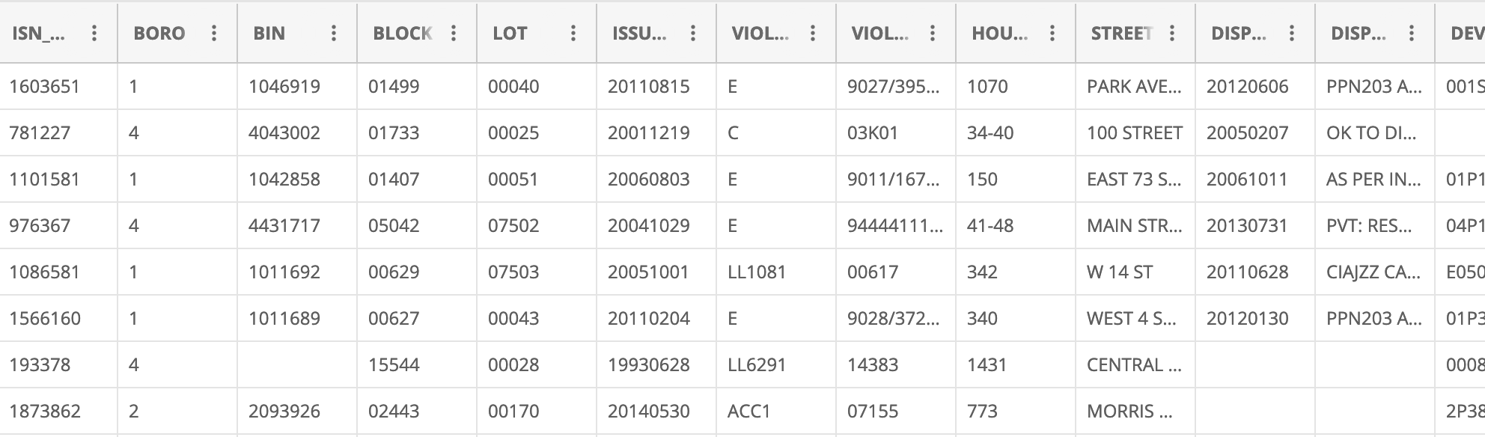
Data Cleaning using Python and Pandas
https://data.cityofnewyork.us/Housing-Development/DOB-Violations/3h2n-5cm9

Slide 89
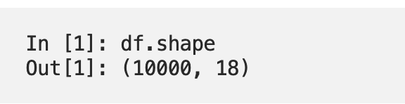
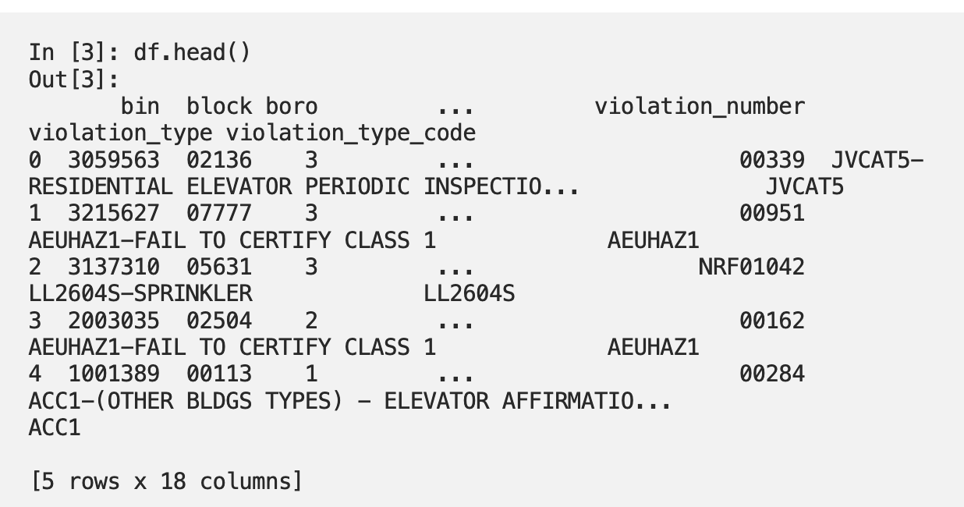
Data Cleaning using Python and Pandas

Slide 90
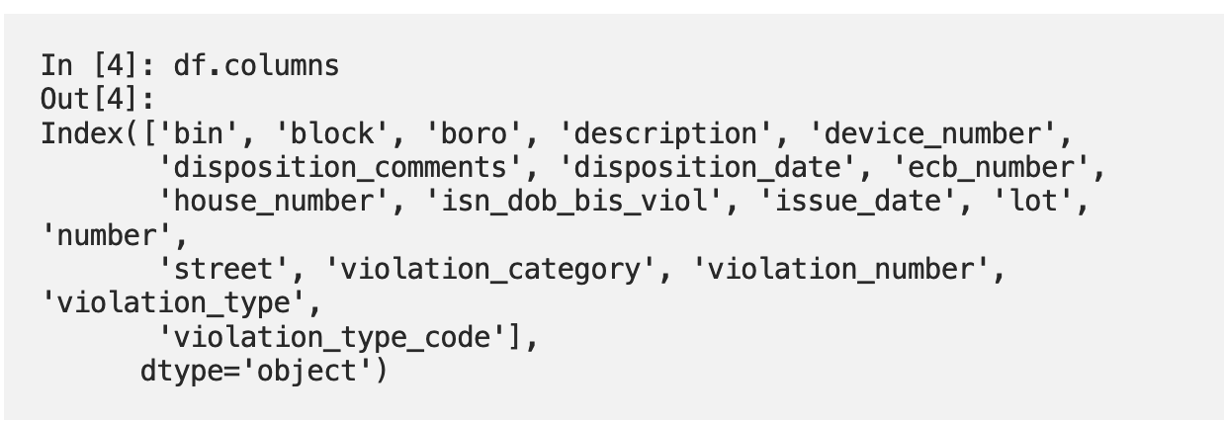
Data Cleaning using Python and Pandas

Slide 91
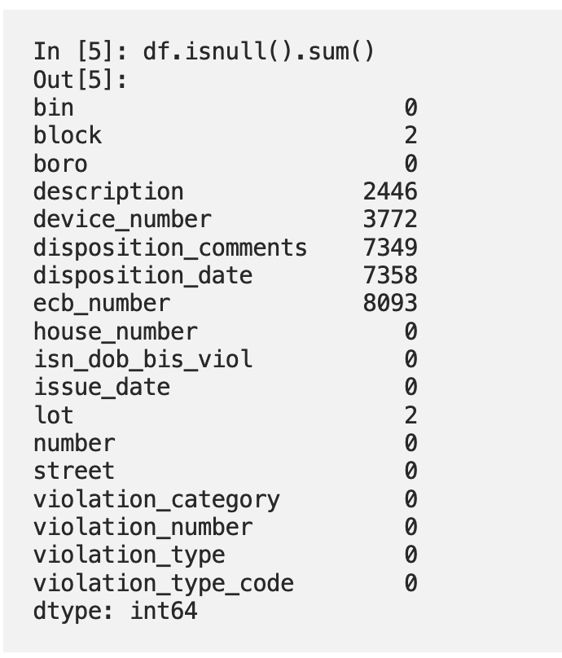
Missing/Null Values

Slide 92
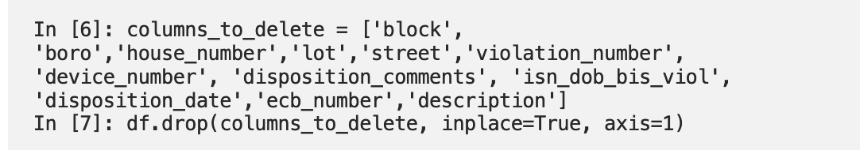
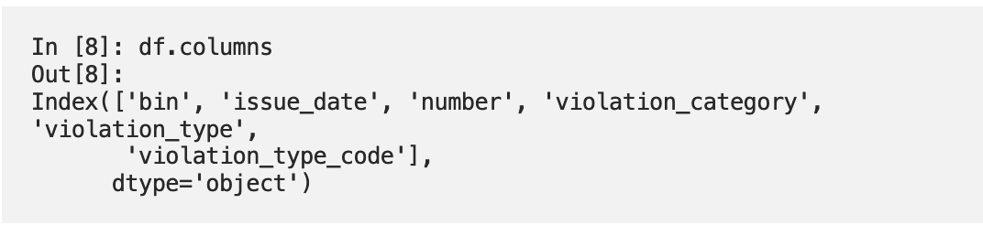
Dropping Irrelevant Columns
Make a list of the columns you want to delete and then pass it to df.drop().
In pandas, axis 0 represents rows and axis 1 represents columns,
so here axis=1 means you are deleting columns.

Slide 93
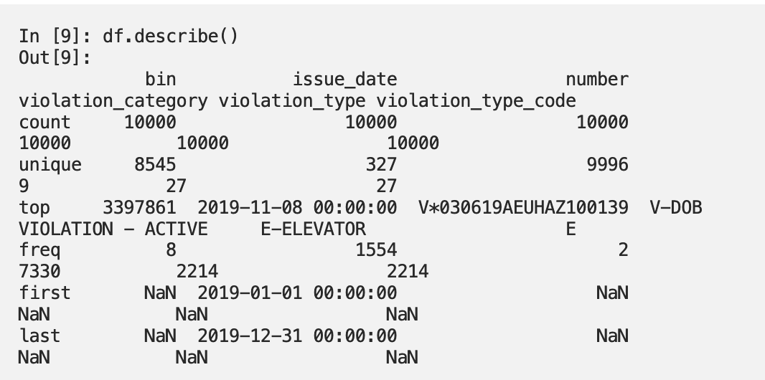
Descriptive Statistics

Slide 94
Data Quality
Datatypes
Constraints
Uniformity
Accuracy
Data consistency
Duplicates

Slide 95
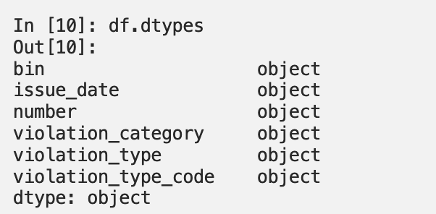
Data Types
It’s important that the data values in each column are the correct data type that you are expecting them to be.
For example, if the data should be in numeric format but you find string data in the column.

Slide 96
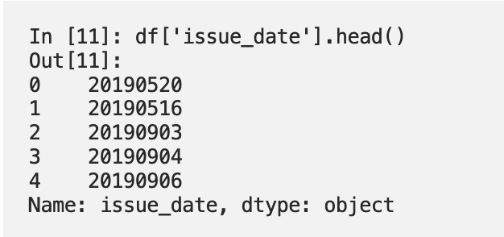
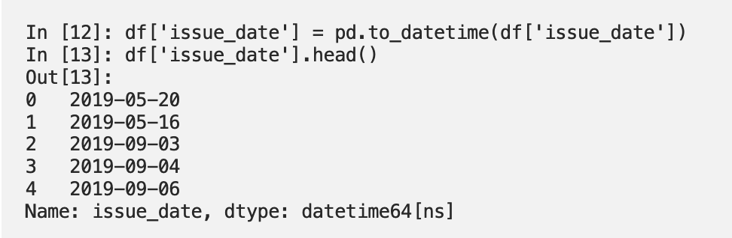
Data Types
The dates are strings in YYYYMMDD format.
We want to convert it to a Python datetime, and pandas has an easy way of doing that with the to_datetime() method

Slide 97
Data Constraints
Make sure any constraints on the data are respected.
There are many types of constraints that you might need to follow with a given dataset.
When cleaning it, you will want to make sure that you test any of them that are relevant.
Date ranges
Number ranges — Minimum or maximum values for a column.
Non-null constraints — If a value should not be null but is.

Slide 98
Data Constraints
Unique constraints — Two or more column values must be unique together in the data.
Foreign key constraints
Patterns — If the data should be in the format of an email address or phone number, it can be validated with regular expressions for these patterns.
If you’re working with geographic data like longitude and latitude, you could set boundaries for acceptable latitude and longitude coordinates if you know where your data points should be located, and if points fall far outside of that boundary you know you need to examine it further.

Slide 99
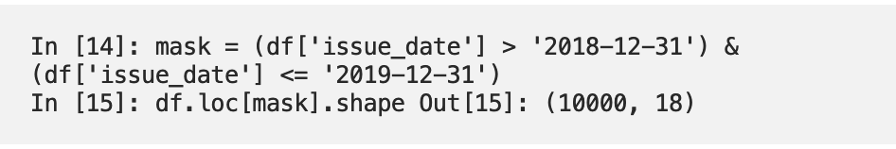
Data Constraints
The building violations data should all have dates in 2019.
We have converted the column to the Python datetime format, so we could test that the date range is correct by creating a boolean mask
An array of True or False values for each item in the column — and then making sure that all rows that return True add up to the number of rows I expect to have.

Slide 100
Uniformity & Data Accuracy
Values in a dataset should be the correct datatype, and they should also be uniform in units as well.
If some samples in a column are in miles-per-hour units while others are in kilometers-per-hour, then any analysis will be based on partially incorrect data.
Checking for data accuracy can be closely tied to the constraints.
A user might enter a U.S. phone number as “000–000–0000”, which is the correct format and would pass any kind of regular expression, but it might not be a real phone number.

Slide 101
Fixing up formats
Often when data is saved or translated from one format to another, some data may not be translated correctly.
For example, The timestamp may contain numbers like 20090609231247 instead of timestamps in the expected format: 2009-06-09 23:12:47.
A typical job when it comes to cleaning data is correcting these types of issues.

Slide 102
Consistency, Duplicates & Missing Values
Data should be consistent across data sources.
If you have data about a retail product, and the price is different in two different tables, it might be a problem.
If a user accidentally submits a form twice, or you scrape a website twice without realizing it, or in plenty of other scenarios, you could end up with duplicate data.
Missing values should be taken care of

Slide 103
What to do with missing values?
First, try to figure out why the data is missing
With the building violations data, it seems reasonable to think that there should always be an issue_date for a violation, so if it were missing then there had likely been a value for it, but it didn’t get recorded properly, or something like that.
On the other hand, there are other columns like disposition_comments, where maybe there was no comment entered, or it hasn’t been entered yet, or comments are optional. So it could reasonably have a null value.

Slide 104
What to do with missing values?
Delete or replace
When a dataset has missing or null values, it’s important to decide what to do about them in the context of your project.
There are two basic options.
Delete rows or columns with missing values.
Replace missing values.

